Slide 1
Miroslav Popovic
Docker & ASP.NET Core 3.0

Slide 2
Introduction

Slide 3
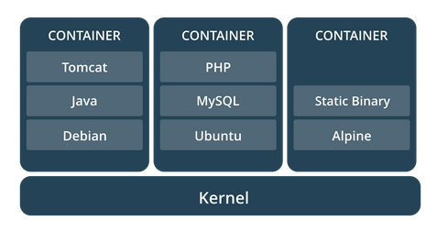
What are containers?
A stand-alone, executable software packages
Encapsulates the app and dependencies
Share the same OS kernel
Isolate software from surroundings
Build once, run everywhere
Shipping containers paradigm

Slide 4
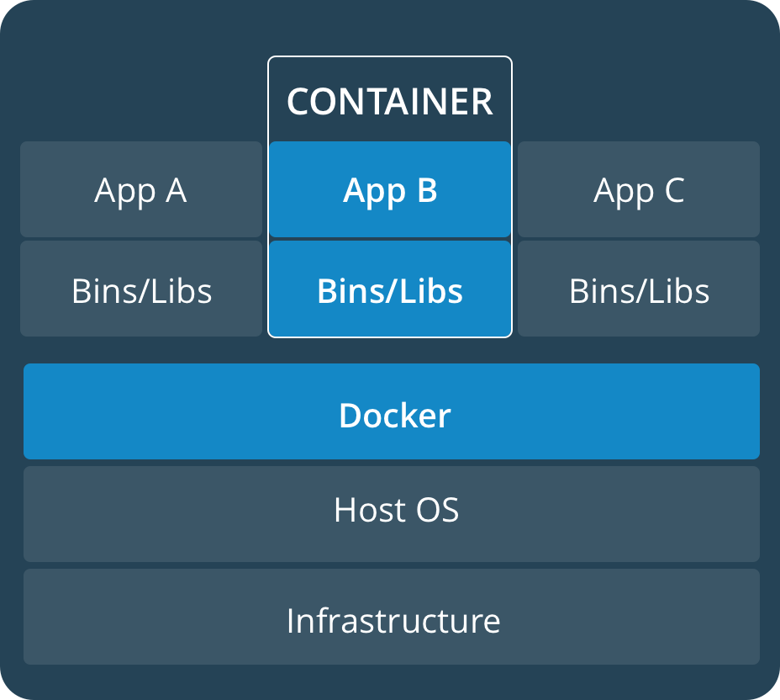
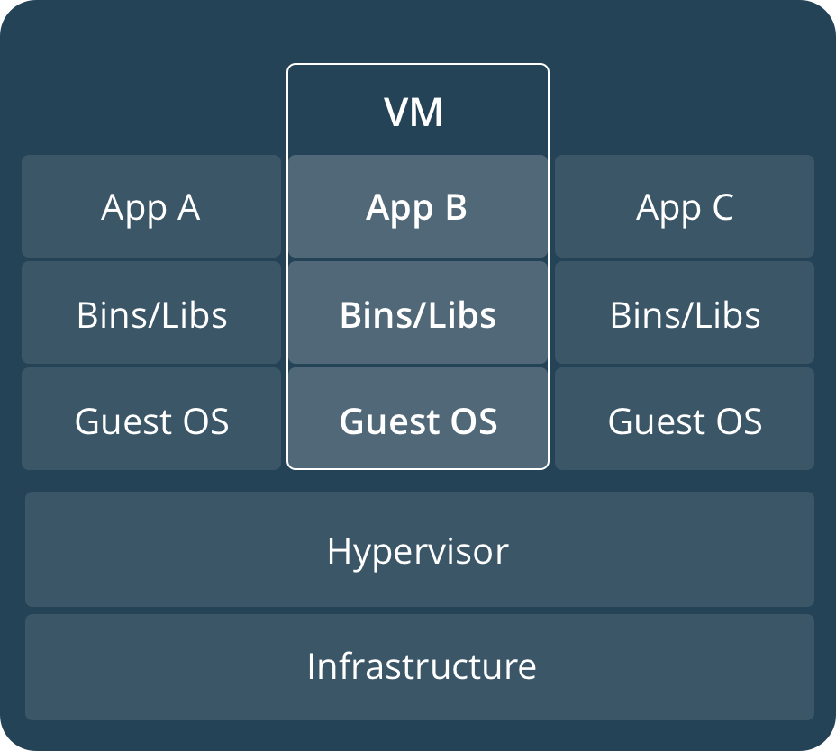
So, like Virtual Machines?
No, more lightweight
Runs as a process
Smaller
Faster

Slide 5
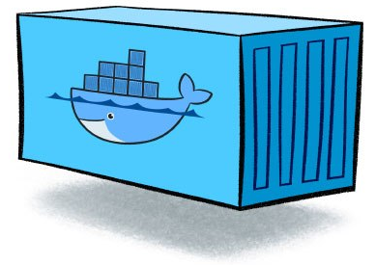
Image vs. container
images / layers
container
WordPress : Php
wordpress:latest
new WordPress()
WordPress instance
Php : Debian
php:7.2-apache
Debian : Scratch
debian:stretch-slim
> docker run
Scratch : System.Object
scratch
Docker daemon
machine
Notes:
Container image from https://www.nebulaworks.com/blog/2016/08/04/docker-container-basics-operations-guide-part-1-3/
- A container is launched by running an image. An image is an executable package that includes everything needed to run an application--the code, a runtime, libraries, environment variables, and configuration files.
- A container is a runtime instance of an image--what the image becomes in memory when executed (that is, an image with state, or a user process).

Slide 6

Docker
Open-Source
Linux and Windows based
Easy to use
Fast
Docker Hub
Modularity and scalability
Docker compose

Slide 7
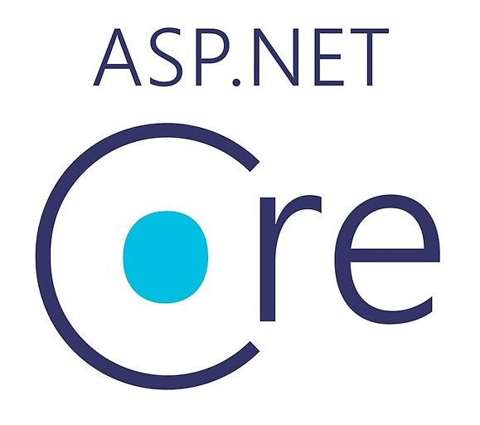
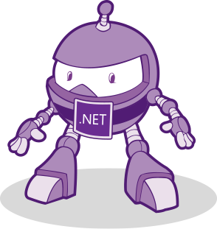
ASP.NET Core
Open-source
Multi-platform
High performance
Size optimized
Microservices ready
The future of .NET ecosystem

Slide 8
Demo

Slide 9
Dev Tools
Visual Studio Container Tools Extension for VS 2019
Docker extension for VS Code
Setting Up a Developer Environment Using Docker by Sahil Malik

Slide 10
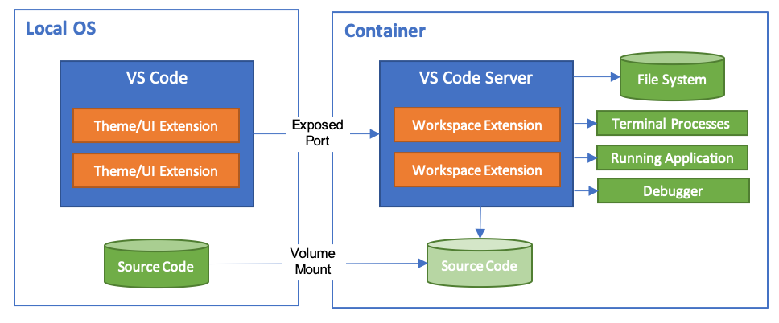

VS Code Remote - Containers
Docker container as dev environment

Slide 11
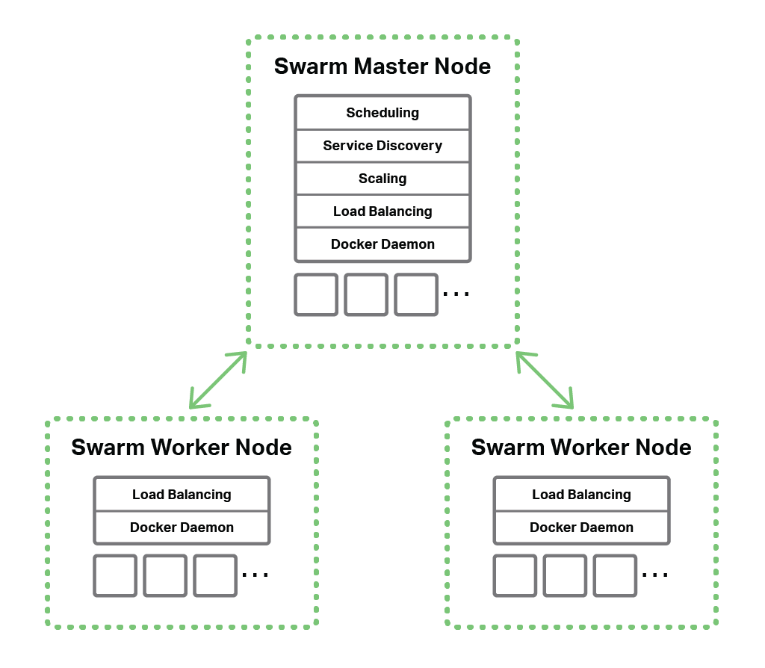


Docker Swarm / Kubernetes

Slide 12
Closing up

Slide 13
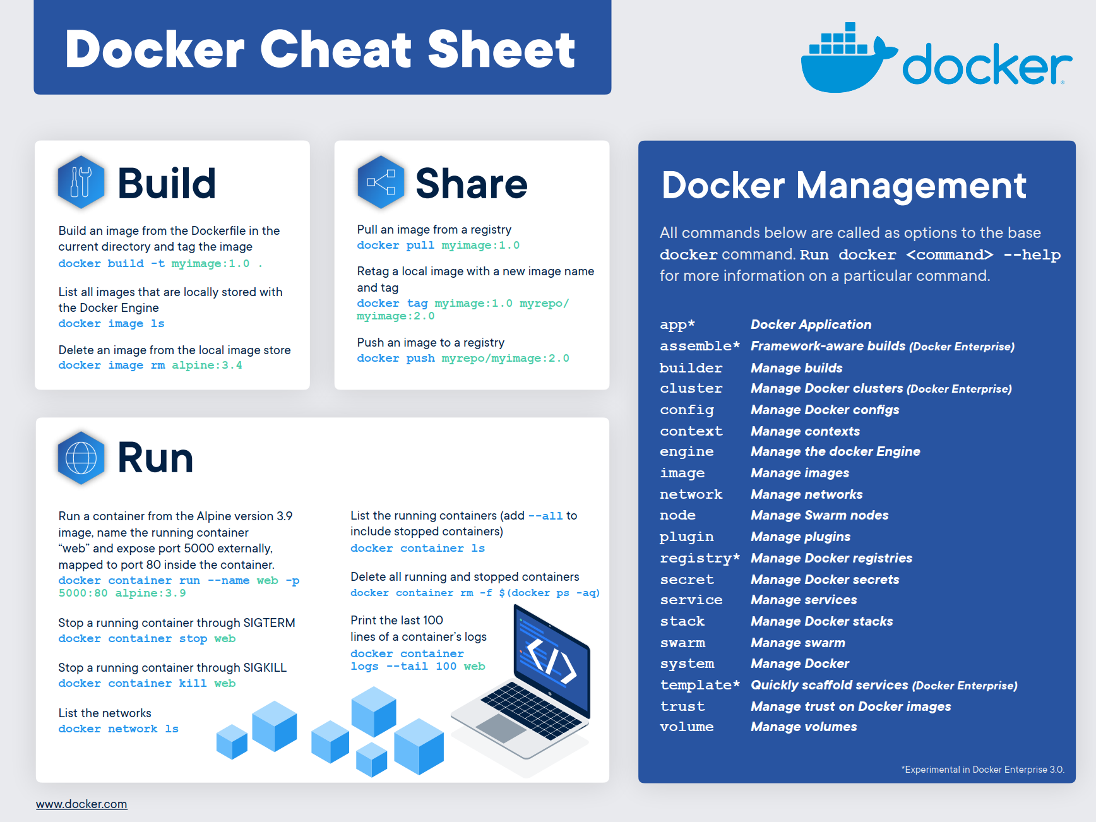

Slide 14
Scenarios
Running Linux software on Windows
Using tools without installation
Integration testing
- https://jeremydmiller.com/2018/08/27/a-way-to-use-docker-for-integration-tests/
CI/CD - DevOps
AWS or Azure deployment
Microservices
…

Slide 15
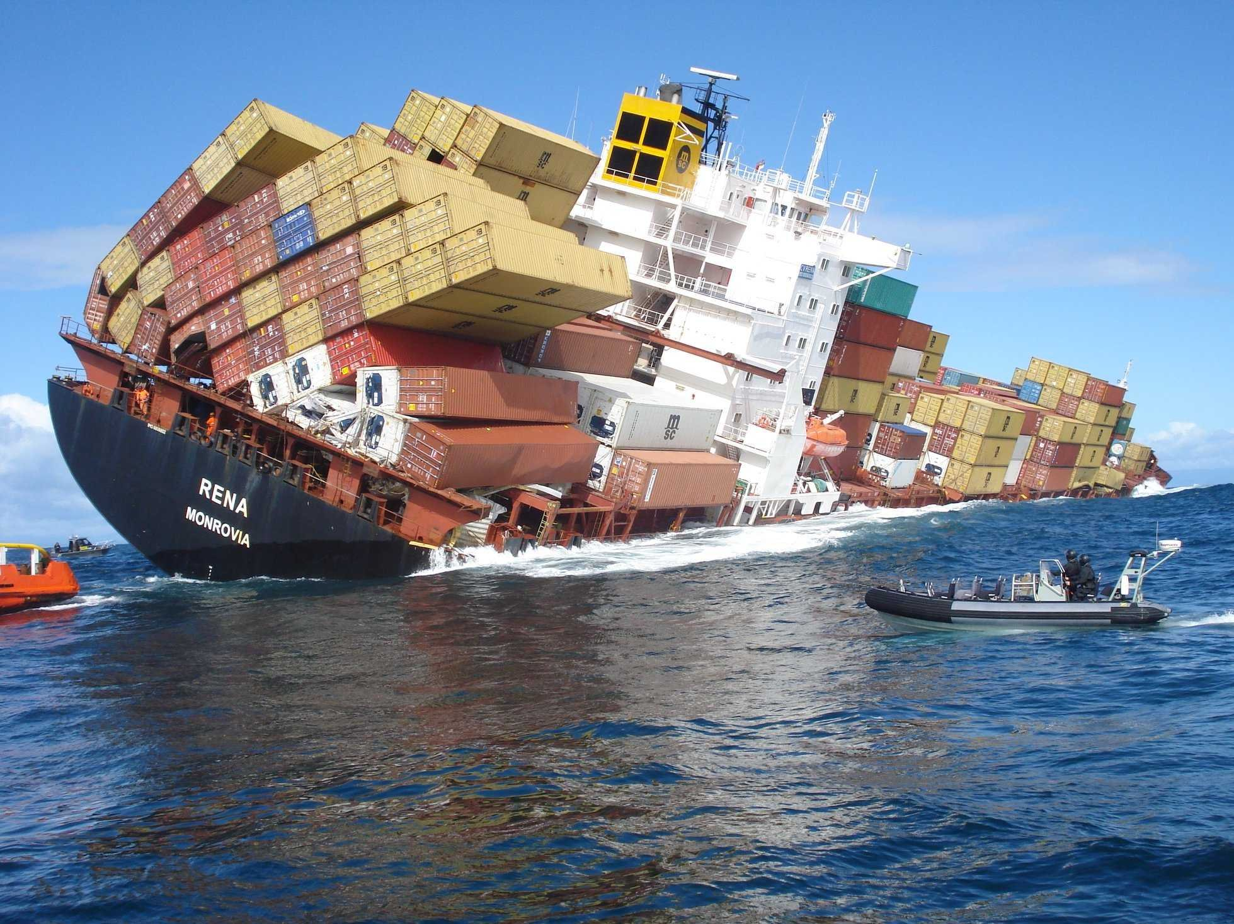
Problems
Most of them are not Docker related
Edge versions
Caching
…
Community
Notes:
Image source: https://vistapointe.net/ship.html

Slide 16
Further research
Docs
https://docs.docker.com/
ASP.NET Core docs - https://docs.microsoft.com/en-us/aspnet/core/host-and-deploy/docker/
Pluralsight courses
https://www.pluralsight.com/paths/managing-containers-with-docker
A start-to-finish guide to Docker for .NET by Daniel Hilgarth
https://stackify.com/a-start-to-finish-guide-to-docker-for-net/
Docker Desktop for Windows Future - WSL2
https://www.hanselman.com/blog/DockerDesktopForWSL2IntegratesWindows10AndLinuxEvenCloser.aspx
The death of Docker? by Maish Saidel-Keesing
https://technodrone.blogspot.com/2019/02/goodbye-docker-and-thanks-for-all-fish.html
Sample
https://github.com/miroslavpopovic/docker-aspnetcore-sample-2

Slide 17
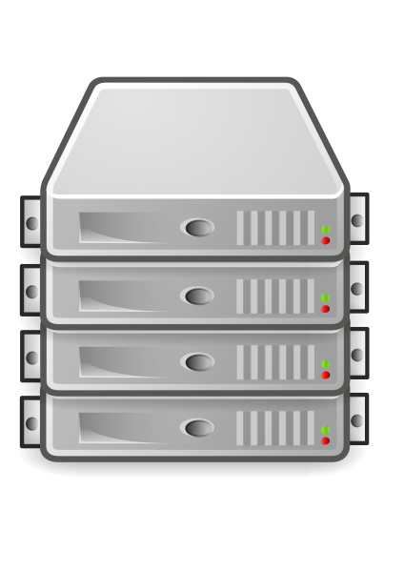
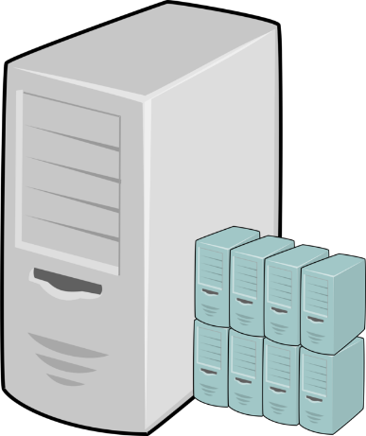


What’s next?
The rise of serverless
https://markheath.net/post/containers-versus-serverless-microservices
Bare metal
Virtual machines
Containers
Functions / Serverless
Notes:
- https://en.wikipedia.org/wiki/File:Server-multiple.svg
https://www.pikpng.com/downpngs/ihioomm_virtual-machine-host-computer-icons-computer-servers-application/
https://akfpartners.com/growth-blog/4-landmines-when-using-serverless-architecture

Slide 18
Thank you!
Questions?
https://miroslavpopovic.com
@miroslavpopovic

